Slide 1


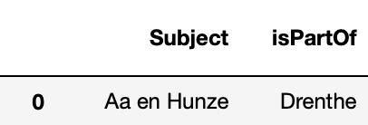
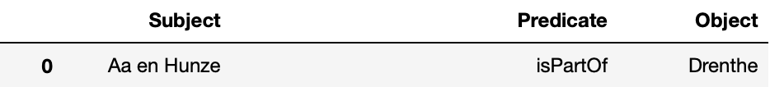
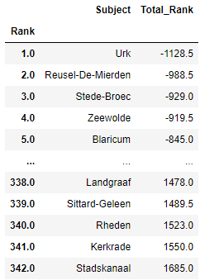
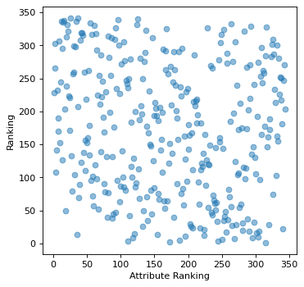
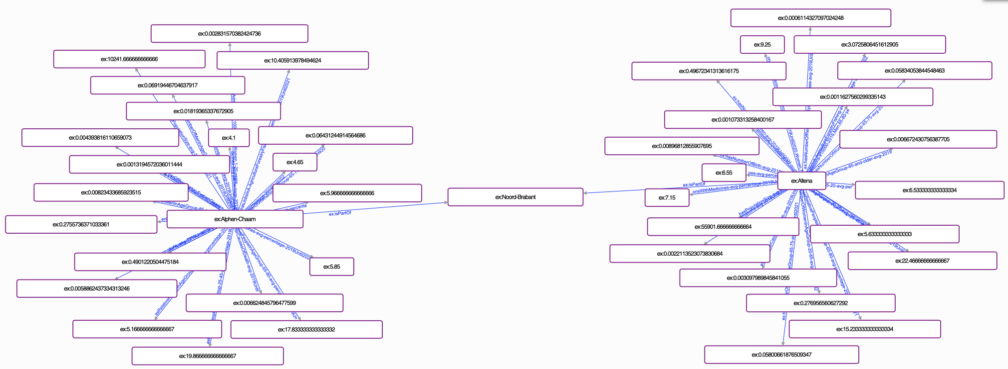
Netherlands' healthiest locations
2AMD20 Knowledge Engineering Group 15
2021-2022 GS4
Sevda Kurt, Kadir Marangoz, Sverre van Mulken, Vasil Shteriyanov
1
Problem and Data Preprocessing
Problem
Data Preprocessing
Knowledge Engineering
Challenges
In which municipality in the NL are people the healthiest?
What attributes can be used as indicators for having a healthy population?
What is the best municipality to live healthy in the NL based on a selection of attributes?
How do population attributes such as job type, educational level, amenities) relate to health within the population of the NL?
All 8 data sources from Centraal Bureau Statistiek: population and health data in dutch municipalities
Removed quotation marks from column names/ values
Convert string number values to numeric; replace “,” decimal point to “.”
Drop columns with <30% non-null values
Impute missing values per province
Average data for multiple years per municipality and province
Translate resulting DF to English
Transform the DF into subject, predicate, object format
Relativize the attributes by dividing over population size per municipality
Converting the attribute naming to a more applicable and meaningful naming scheme
Constructing an understandable way to represent all provided data through knowledge graphs
Preparing the data to maintain its meaning when combined
Creating a meaningful way to compute a ranking on any combination of attributes
Narrowing down the definition of healthiness
Constructing a method to relativize the attribute data
2
Implementation
Querying
Ranking
Usage
Convert the provided input file to a list of predicates and weights
Collect all predicate data
Filter incomplete rows
Rank each predicate individually
Combine the individual ranks using the weights
Compute the final ranking
Convert all attribute data into an ascending ordering (rank)
Sum each individual rank by first multiplying with the provided weight and then adding it to the total
If an attribute should be ordered in descending order, the weight should be negative
Convert the total obtained ranking for each location to another ascending ordering (rank)
Create a weighing of all predicates as desired, for some purposes some features may be more important than others
Once the file with weightings is created, run the ranking script through the CLI with the options and flags as required
Rankings are outputted as aggregated total rankings overall all predicates and the total rankings over each individual predicate in separate files
3
Results
Obtained Ranking
Correlations
An example rank.:
Attributes on:
Education
Job division
Birth
Death
Disease
Medicated population
Resulting ranking shows Urk as the healthiest place and Stadskanaal as the least healthy place.
The correlation between the number of unmarried people in each place and the achieved ranking. Hinting that (without context) an increase in unmarried people may lead to a better ranking.
Computed using the ranking of the input attributes and the ranking over the possibly related attribute itself.
Knowledge Graph

